Slide 1
CONTEXT FOR THE REVIEW
Michael Farrar, Ph.D.
Deputy Assistant Administrator
for Labs and Cooperative Institutes (A)
Office of Oceanic & Atmospheric Research
June 21, 2016
Notes:
Thank you. I appreciate the opportunity to talk with you today.
Segue: I’d like to set the stage by talking a bit about OAR’s role at NOAA, some efforts we have undertaken to look at how we manage NOAA’s research and development portfolio, the fiscal environment in which we are operating, and where I see OAR heading in the future.
I will then follow with more details regarding the State of ARL today.

Slide 2
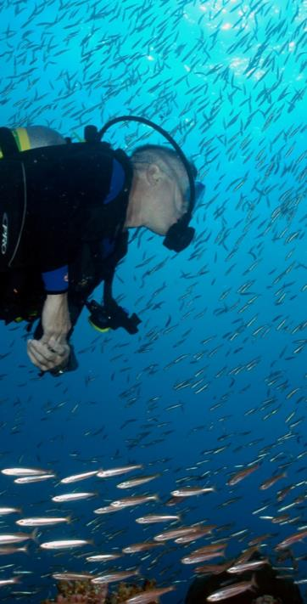
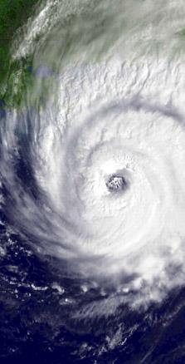
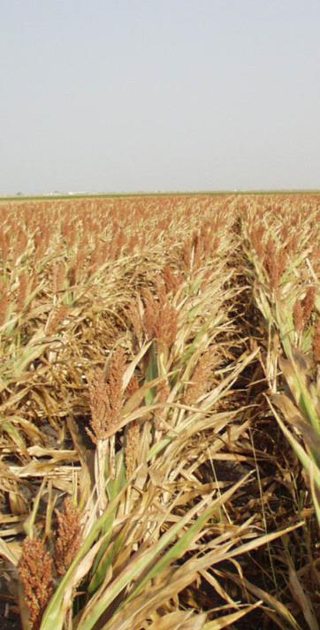
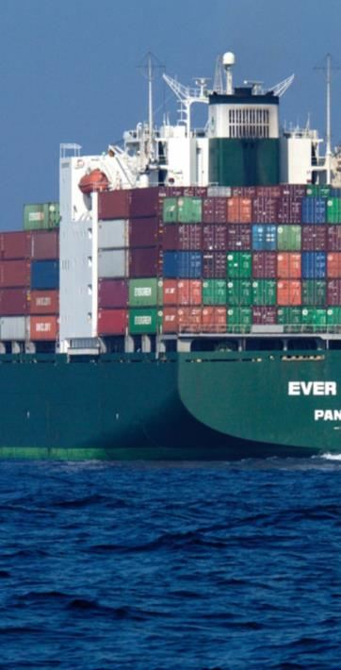
NOAA’S NEXT GENERATION STRATEGIC PLAN GOALS
Healthy Oceans
Weather Ready Nation
Climate Adaptation & Mitigation
Resilient Coastal Communities & Economies
SCIENCE & TECHNOLOGY
Notes:
NOAA’s mission is to understand and predict changes in the Earth’s environment, to conserve and manage coastal and marine ecosystems and resources, and to share that knowledge and information with others to meet our Nation’s economic, social, and environmental needs. NOAA Research is at the heart of NOAA’s research and development enterprise and is the innovation engine for achieving NOAA’s strategic vision and long-term goals.
NOAA’s Long-Term Mission Goals:
Healthy Oceans
Marine fisheries, habitats, and biodiversity that are sustained within healthy and productive ocean ecosystems
Weather Ready Nation
A society that is prepared for and responds to weather-related events
Climate Adaptation & Mitigation
An informed society anticipating and responding to climate and its impacts
Resilient Coastal Communities and Economies
Coastal and Great Lakes communities are environmentally and economically sustainable
In addition to the four thematic mission goals, NOAA also recognizes the inherent need for support. This is captured in the NOAA Enterprise Objectives: Science and Technology, Engagement, and Organization and Administration. Underpinning the S&T Enterprise are a holistic understanding of the Earth system through research, accurate and reliable data from integrated earth observations, and an integrated environmental modeling system.
NOAA is essentially America’s Environmental Intelligence Agency with global activities on land and sea, in the air and in space. NOAA relies on science partnerships to achieve our mission. NOAA partnerships span academic and industry sectors as well as other government agencies. These critical relationships improve relations with our customers, build reliable interconnected data sources, and support NOAA’s mission.

Slide 3
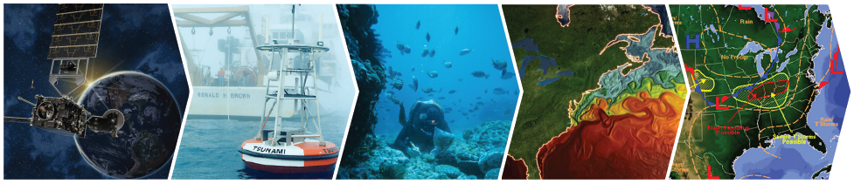
America’s Environmental Intelligence Agency: 2014 - 2018 Priorities
MONITORING
MODELING
OBSERVATIONS
ASSESSMENT
FORECAST &
PRODUCTS
Provide information and services to make communities more resilient
Evolve the Weather Service
Invest in observational infrastructure
Achieve organizational excellence
Notes:
The scientists at NOAA Research are among the most innovative in the world. We contribute to the American people daily by providing outstanding science innovation and products, enabling NOAA to be a leading provider of environmental intelligence in the atmosphere, weather, oceans, and climate. Dr. Sullivan sees "environmental intelligence" at the core of our mission, and as you should be aware, has outlined NOAA’s four high level priorities:
Provide information and services to make communities more resilient
Evolve the Weather Service
Invest in observational infrastructure
Achieve organizational excellence
Images:
Observations: GOES-R satellite
Monitoring: DART Buoy
Assessment: NOAA Diver collecting data on corals.
Modeling: GFDL model on sea surface temperature
Forecast & Products: NWS forecast alerts of severe storms and flooding.

Slide 4
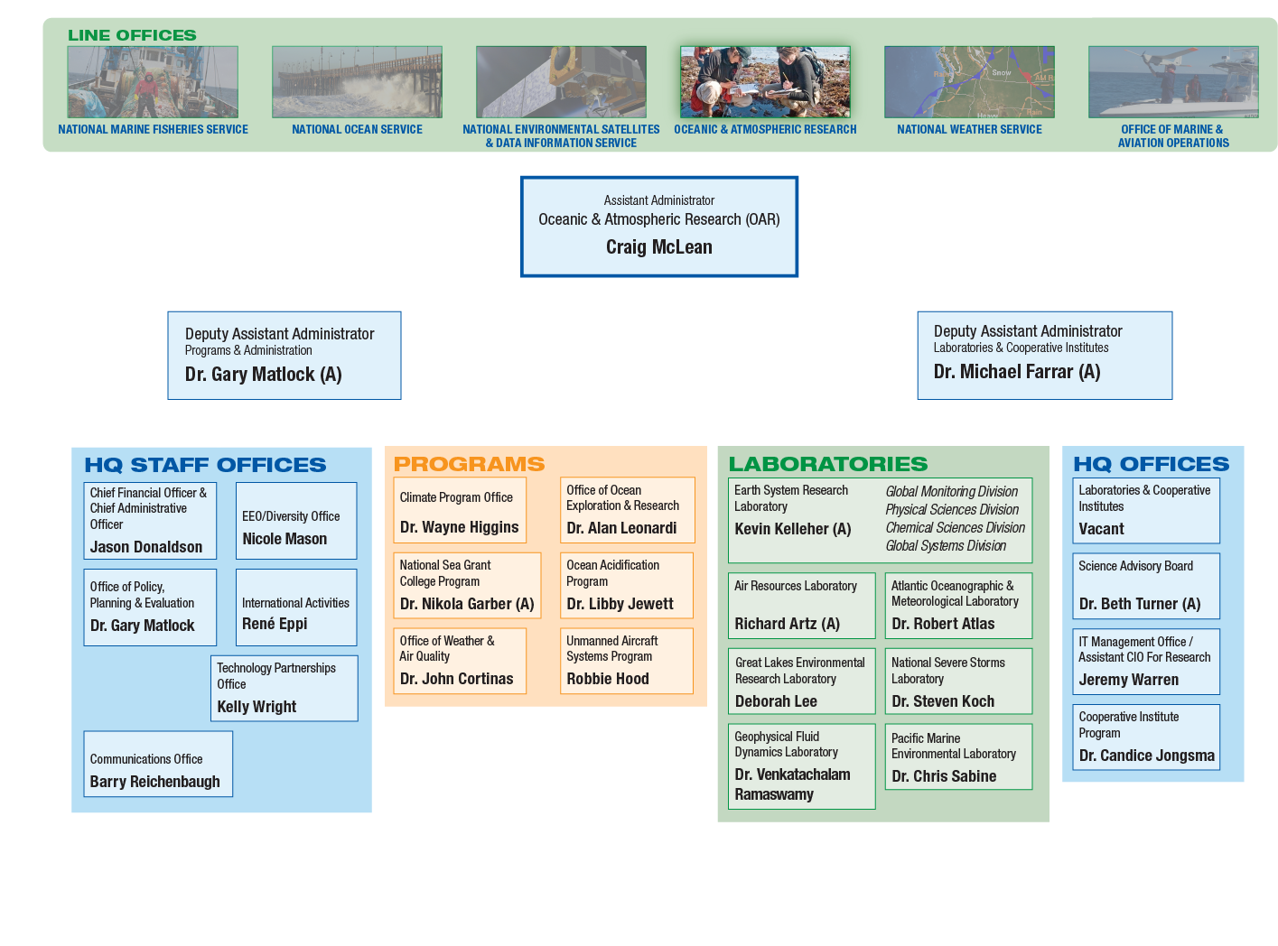
OAR’S ORGANIZATION WITHIN NOAA

Slide 5
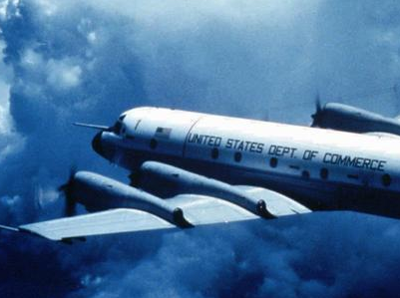

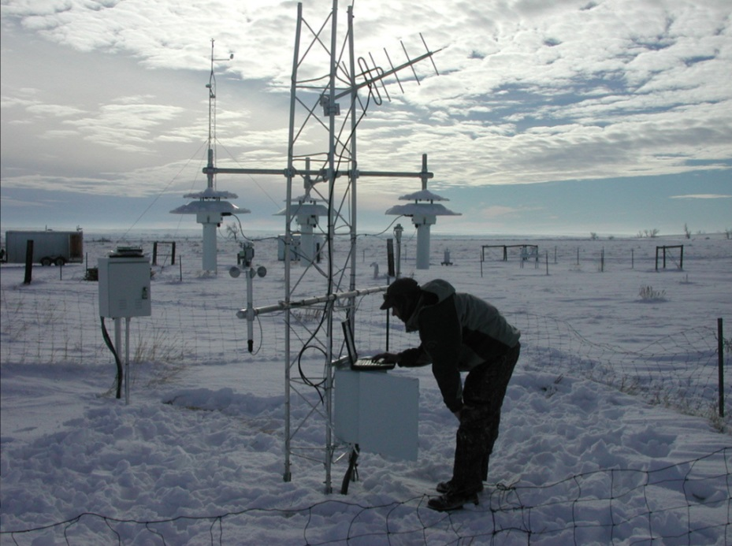
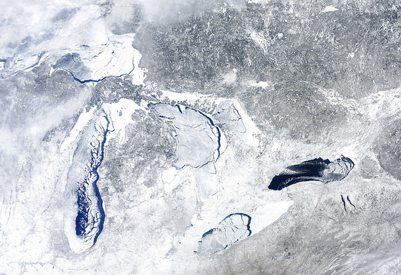
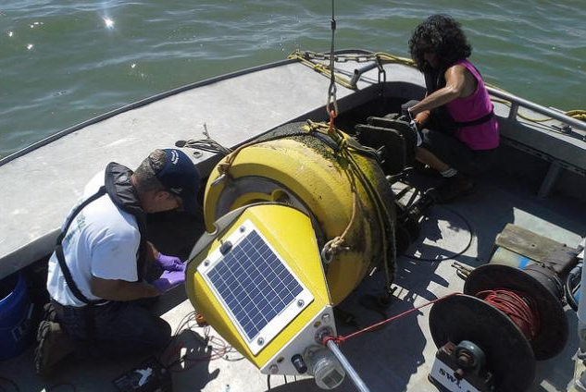
OAR’S VISION & MISSION
To Deliver NOAA’s Future.
Conduct research to understand and predict the Earth’s oceans, weather and climate, to advance NOAA science, service and stewardship and transition the results so they are useful to society.
VISION
MISSION
Notes:
Main Message: Preeminent research is at the center of all NOAA Services.
OAR Vision: Be a trusted world leader in observing, modeling,
understanding and predicting the Earth system. (per OAR 2014 Strategic Plan)
OAR Mission: Conduct research to understand and predict the
Earth system; develop technology to improve
NOAA science, service and stewardship; and
transition the results so they are useful to society. (per OAR 2014 Strategic Plan)
OAR specializes in improving operational capabilities, and improving our understanding of the Earth system across NOAA’s mission areas. OAR conducts R&D that increases our knowledge of climate, weather, oceans and coasts, and it increases the effectiveness of NOAA’s service lines, as well as a great range of partners in the public, private, and academic sectors.
The science and technology that OAR produces and transfers to partners
(in NOAA’s service lines and beyond) is instrumental to preventing the loss of human life, managing natural resources, and maintaining a strong economy.
Vision Image: A P-3 Orion research plane belonging to NOAA flies toward a hurricane in this 1980s photo , Credit AP Photo/NOAA
Mission Image: Maintenance of a U.S. Climate Reference Network Station , Credit Air Resources Laboratory

Slide 6

POWER OF PARTNERSHIPS
Labs
Programs
Partners
Key OAR Partners: Cooperative Institutes and Sea Grant Programs
Notes:
Main Message: OAR is unique within NOAA and compared to many other Federal science agencies in that it supports research: (1) at “in-house” laboratories; (2) through programs; and (3) through partners with funding through our Cooperative Institutes, Sea Grant College Program, RISAs, and Competitive Grants.
In all cases they are supporting goal-oriented research aimed at improving NOAA’s ability to meet its mission requirements.
Why have labs?
• to maintain highly specialized, unique expertise in key areas over many years (e.g. weather radars)
• to translate research results into applications and operations to address NOAA’s mission requirements (e.g. products such as HWRF or HRR for the NWS; DART buoys)\)
• to conduct long term monitoring of ocean and atmosphere and contribute to regional and national assessments (e.g. GOOS, GMD, IPCC)
Why have programs?
• to foster collaboration across NOAA, with other Federal agencies and with the University community (e.g. Sea Grant, CPO)
• to provide a focus on specific topics and emerging areas of research (e.g. OA)
• to execute programs specifically authorized by Congress (e.g. OER, OWAQ)
Why have partners?
• to provide OAR access to expertise and technical capabilities it doesn’t have in-house (e.g. social sciences)
• to provide flexibility to rapidly shift priorities and increase or decrease staffing levels
• to provide access to students, post-docs and early career scientists that continually bring new blood and fresh ideas to OAR

Slide 7
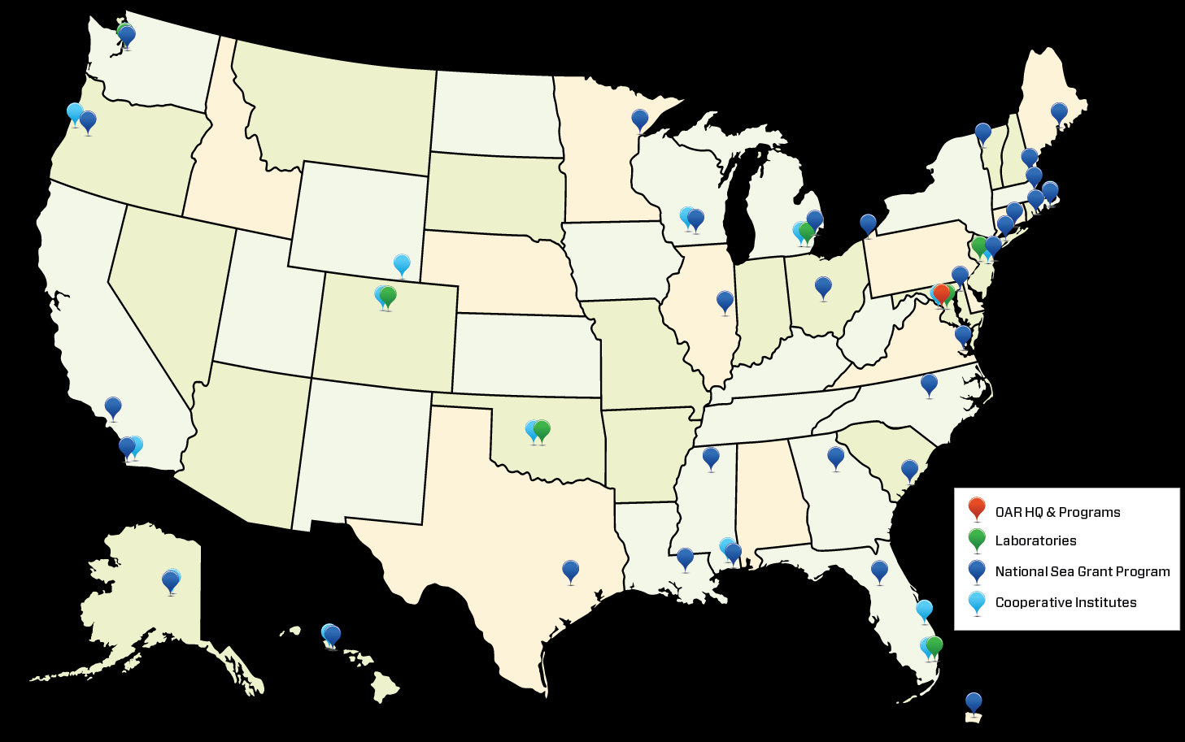
WHERE IS OAR?

Slide 8
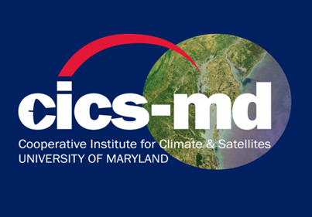
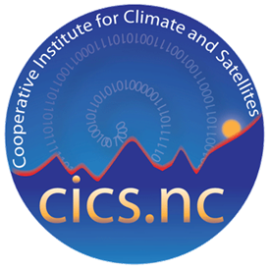
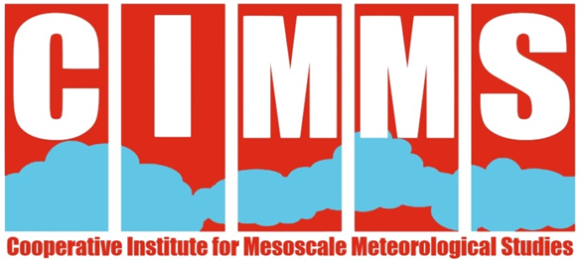
COOPERATIVE INSTITUTES
Are NOAA supported, non‐federal organizations located at degree-granting institutions whose research reinforces NOAA’s mission and priorities
Are often co-located and collaborate directly with NOAA’s diverse research communities, programs and labs
Have portfolios ranging from satellite climatology and fisheries biology to atmospheric chemistry and coastal ecology
Provide complementary scientific expertise
Widen pool of young scientists in topics of interest to NOAA
Notes:
ARL Partners with three cooperative institutes which we will hear about later today:
Cooperative Institute for Climate & Satellites, Maryland (CICS-MD): a partnership with University of Maryland, College Park
Cooperative Institute for Climate & Satellites, North Carolina (CICS-NC): a partnership with North Carolina State University, Ashville
Cooperative Institute for Mesoscale Meteorological Studies (CIMMS): a partnership with University of Oklahoma

Slide 9
ARL RESEARCH DRIVERS
LEGISLATIVE DRIVERS
1990 Clean Air Act Amendments *
33 U.S.C. § 145—Harmful Algal Bloom And Hypoxia Research And Control Act Of 1998, 2014 **
15 U.S.C. § 2901 - National Climate Program Act **
15 U.S.C. § 1525, 1540 – Cooperative Agreements / Reimbursement to Further NOAA’s Mission **
POLICY DRIVERS
National Ocean Policy
United States Global Change Research Program (USGCRP)
Great Lakes Restoration Initiative Action Plan II (2014-2019)
U.S. Department of Commerce Strategic Plan for Fiscal Years 2014-2018
NOAA's Next Generation Strategic Plan (2010)
NOAA’s Understanding Global Ecosystems to Support Informed Decision-Making: A 20-Year Research Vision
NOAA Five-Year Research and Development Plan (2013-2017)
NOAA Annual Guidance Memorandum FY2016-2020
OAR Strategic Plan (2014)
The National Response Framework -- The Federal NRF Annexes, approved by the President in January, 2008
Long-term Inter-Agency Agreements between NOAA and DOE to provide support to the DOE’s Idaho National Laboratory and Nevada National Security Site for consequence assessments
FRD: DOE Idaho Operations Office for the NOAA/INL Meteorological Research Partnership since 1949. MOA between OAR and DOE-ID (2012) Dispersion modeling and expert advice in an Emergency Operations Center setting; Dispersion mesonets; MOA between OAR and DOE (2014) HYSPLIT for Radiation Applications (HYRAD)
SORD: started as Weather Bureau Research Station (Department of Commerce) in 1956
Partnerships with International Civil Aviation Organization, World Meteorological Organization, Comprehensive Test Ban Treaty Organization, Department of State, U.S. Nuclear Regulatory Commission
Notes:
Main Message: ARL is responsive to a variety and number of external policy and legislative drivers.
*Amendments listed separately
** not sure if the specific statute is correct

Slide 10
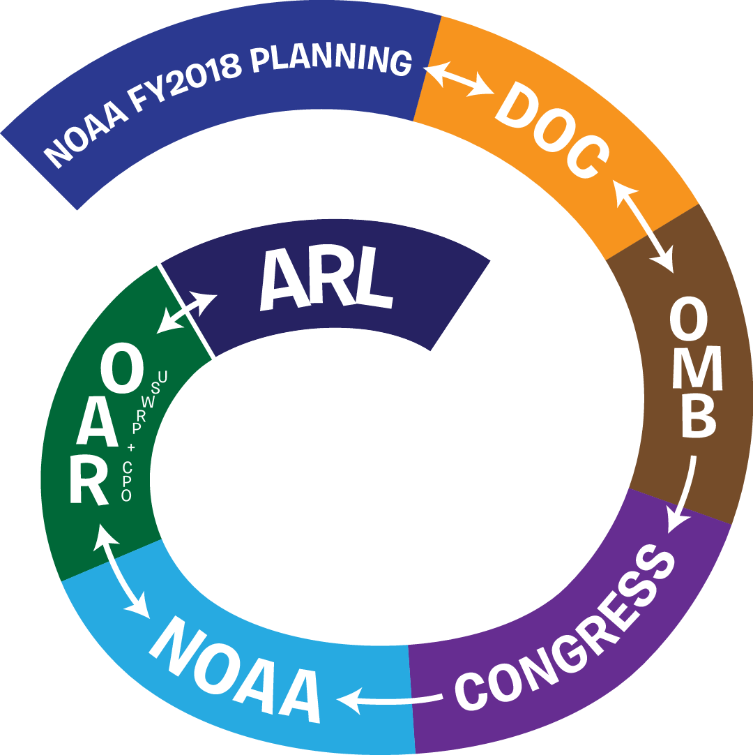
NOAA’S FUNDING PROCESS
Notes:
OAR Budget Documents:
Budget documents prepared 1-1.5 years in advance
Describe activities that will be performed
Include performance measures and milestones
E.g., “Expand cumulative number of dispersion and air quality prediction system updates transitioned to the NWS for operational forecasting, in order to serve federal, state and local air quality agencies, emergency managers, and international public health organizations.”
“Deliver to NWS a forecasting system tailored for global chemical transport model coupling capable of tracking smoke and dust plumes originating from outside the continental US. ”

Slide 11
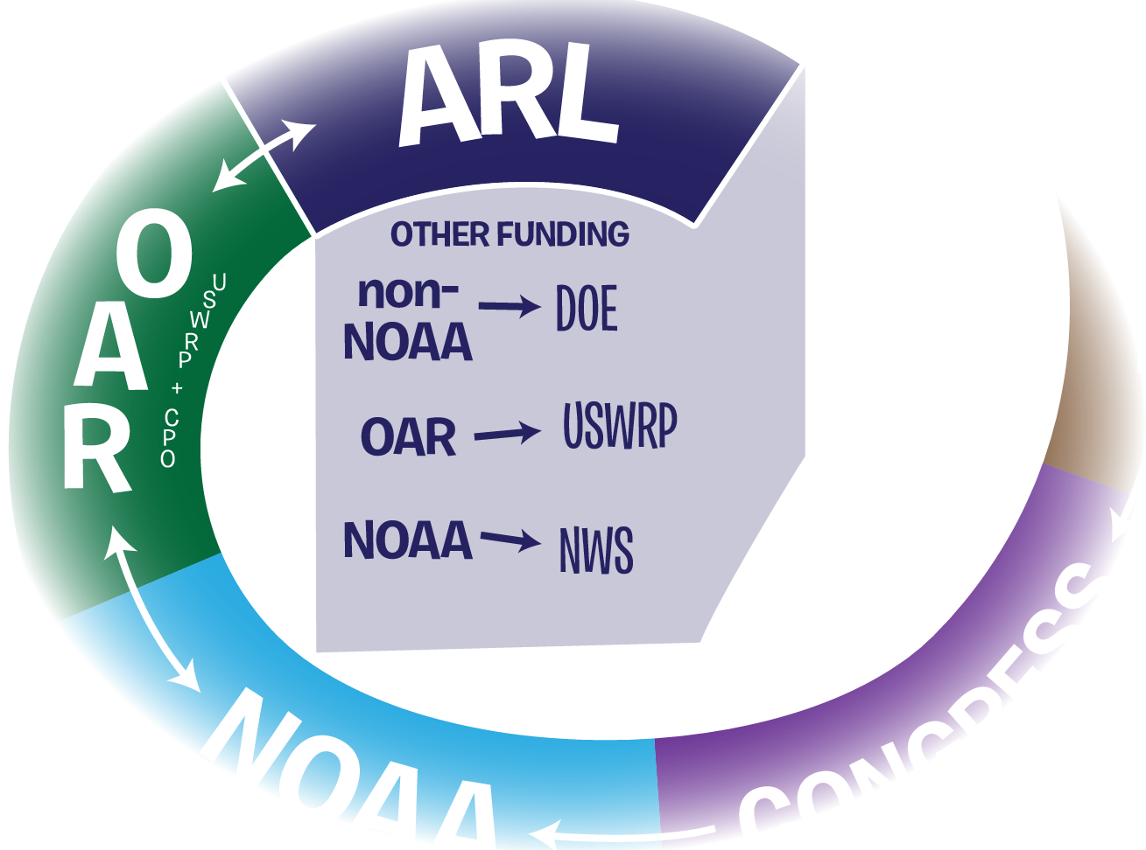
NOAA’S FUNDING PROCESS
Notes:
NOAA Funding:
NOAA → National Weather Service
OAR → US Weather Research Program
Non-NOAA funding:
Department of Energy

Slide 12
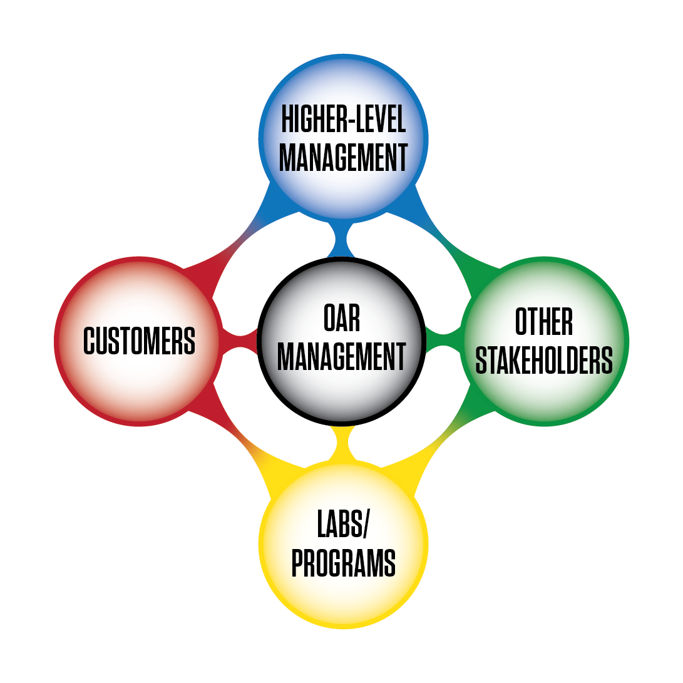
NOTIONAL APPROACH TO PLANNING R&D
Various balances of
input from top and bottom
Notes:
Strategic Documents:
DOC Strategic Plan
NOAA Next Generation Strategic Plan
ARL’s R&D supports two NOAA long-term goals: “A Weather-Ready Nation”, and “Resilient Coastal Communities and Economies”
As well as NOAA’s “Science and Technology Enterprise objective”
NOAA Administrative Orders
Include:
R&D Enterprise Administrative Order: Defines a path to take from basic research, to applied research, to operations
R2A Administrative Order: Further defines how to transition R&D to applications, commercialization, or other uses
Scientific Integrity Administrative Order: Undermines all of the research done in these efforts
The Next Generation Strategic Plan and NOAA Administrative Orders guide the formation of NOAA Five –Year Research Plan 2013 - 2017
ARL’s R&D seeks to address the key questions in NOAA Five Year R&D Plans:
“How can we improve forecasts, warnings, and decision support for high-impact weather events?”
“How are atmospheric chemistry and composition related to each other and ecosystems, climate, and weather?”
These above plans and orders shape the OAR Strategic Plan
Lab reviews are part of what strengthen the R&D enterprise
Lab reviews can help to highlight future strategic plans for OAR and NOAA
Informed by evaluations
The lab reviews have worked so well the same approach is now being applied to OAR programs
Laboratory Strategic Plan
Draws from all of the above plans
Annual Plans and other guidance:
NOAA Annual Guidance Memorandum
Annual Operating Plans with -
Performance Measures
Milestones
Individual Performance Plans
Short-term funding opportunities
Guidance for Changes in Funding Levels
E.g., Maintain long-term observations, intermural-extramural balance
Other guidance—e.g., accelerate/enhance transition of research to applications, ecosystem forecasting

Slide 13
CHARGE TO REVIEWERS
QUALITY: Assess quality of lab’s R&D
RELEVANCE: Assess lab’s R&D relevance to NOAA’s mission & value to Nation
PERFORMANCE: Assess overall effectiveness of lab’s plans & R&D in meeting NOAA’s Strategic Plan objectives & Nation’s needs
Notes:
A reminder of our Charge to the Reviewers:
Three focus areas:
Quality: Assess quality of research over the last 5 years, and whether appropriate approaches are in place to ensure high quality work will be performed in the future.
Relevance: Assess the degree to which research and development is relevant to NOAA’s mission and of value to the Nation.
Performance: Assess the overall effectiveness with which the laboratory plans and conducts its research and development.
These focus areas are expanded upon in Appendix B of the ARL Review Panel Guide that was provided to the Reviewers last month.
Photo credit: ARL

Slide 14
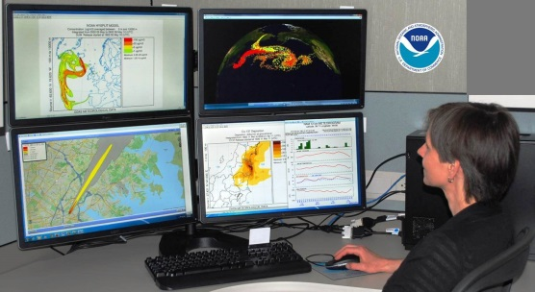
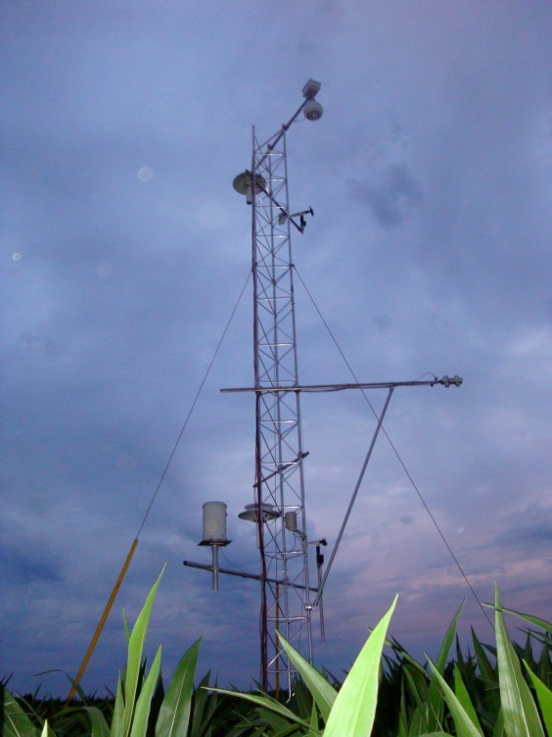
HOW OAR USES YOUR REVIEW
Inform performance improvements and portfolio management;
Encourage innovative and collaborative approaches to meet goals and objectives;
Assess research contributions and clearly articulate the value of the research toward achieving the NOAA mission and as appropriate interagency goals;
Evaluate the outcomes of OAR research, development, and transition; and
Highlight directions for future strategic plans.
Notes:
Lab reviews help to shape the OAR Strategic Plan
Lab reviews are part of what strengthen the R&D enterprise
Lab reviews can help to highlight future strategic plans for OAR and NOAA
Informed by evaluations
The lab reviews have worked so well the same approach is now being applied to OAR programs

Slide 15
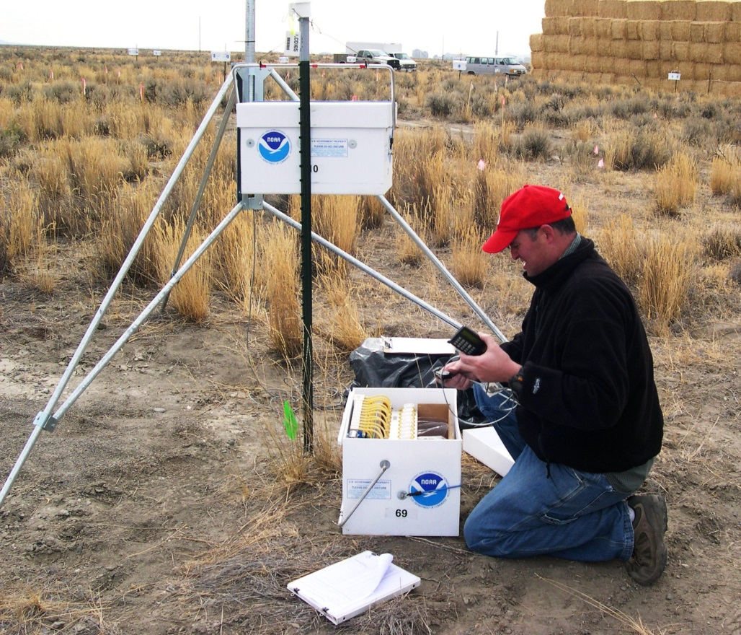
HOW OAR USES YOUR REVIEW
Thank you for your time and effort in the review process.
We appreciate your hard work, and hope you enjoy learning about the current science at ARL
Notes:
Photo credit: ARL

